Slide 1
Guide to Optagelse.dk - https://www.optagelse.dk/

Slide 2
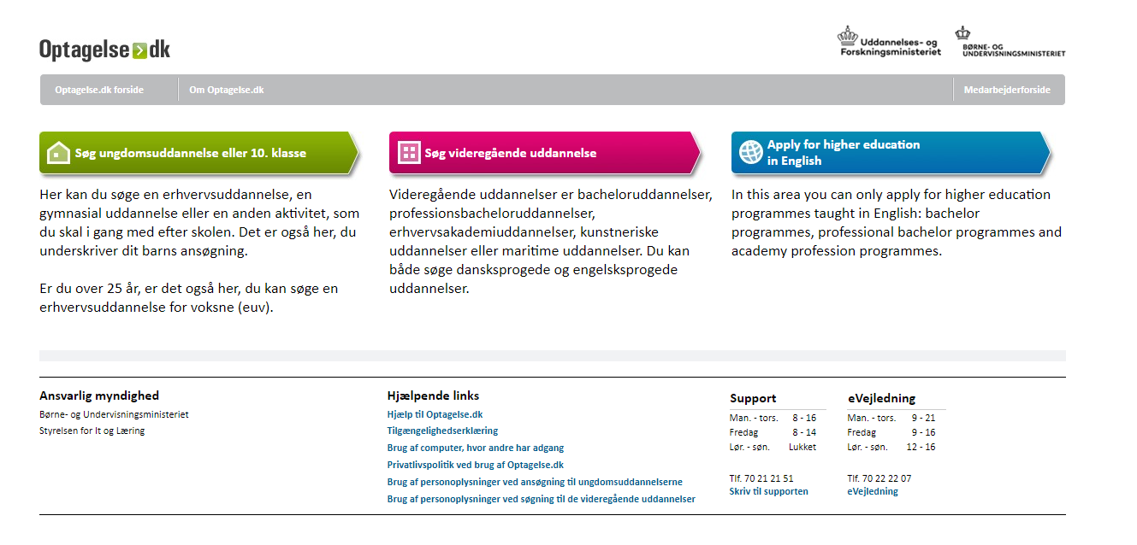
Click here to apply to the Pre-IB. Please remember also to
apply via our own online application form on our
website.
If applying to the IB Diploma Programme, you only need
to apply via optagelse.dk if you are also applying to a
Danish educational programme (stx, hhx etc.).

Slide 3
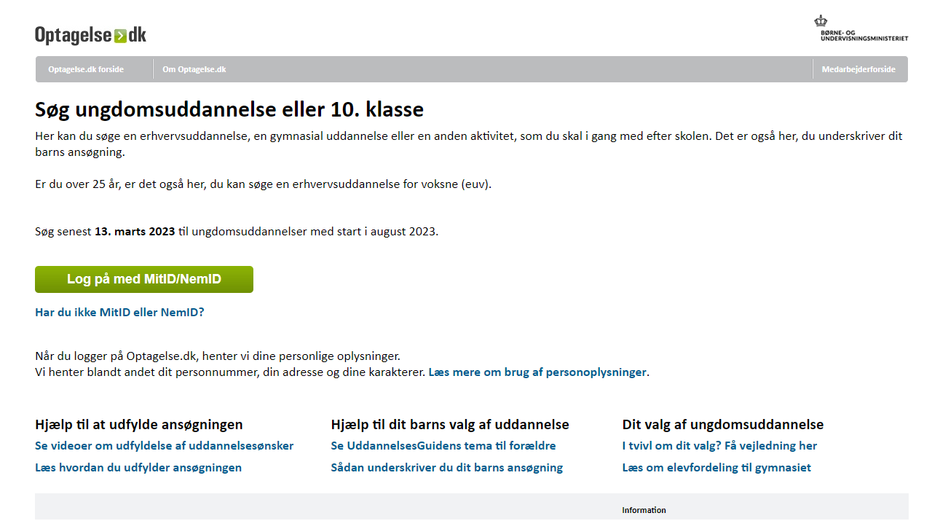
Click here to log-in if you do
not have MitID or NemID.
Click on the green box if you
have MitID/NemID.

Slide 4
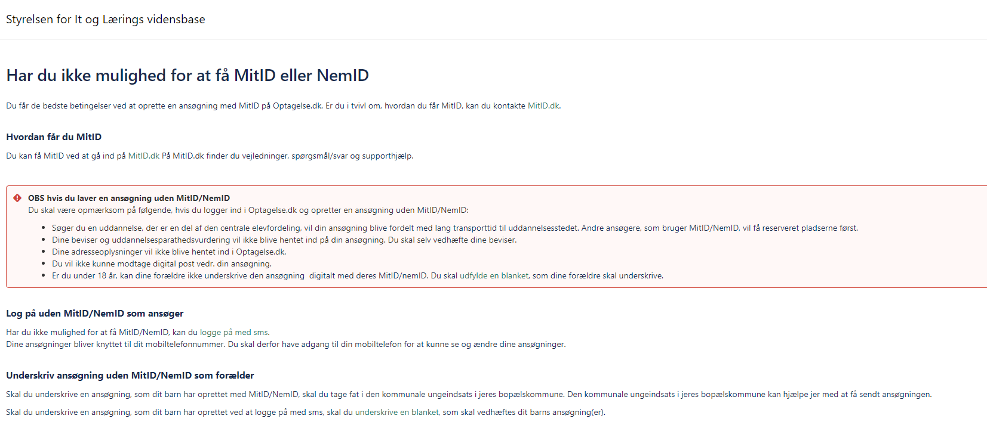
Click here to log-in if you do
not have MitID or NemID.
Click here to get access to the parent consent form
which you must upload if you do not have MitID/NemID.

Slide 5
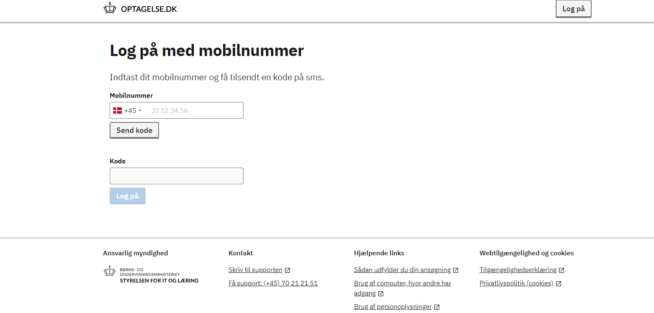
Enter your phone number
here.
Your application will be linked to your
phone number. If you log out, you can
get access to your application again by
requesting a new code with your phone
number.
Enter the code that you have
received via sms and click on
”Log på”.

Slide 6
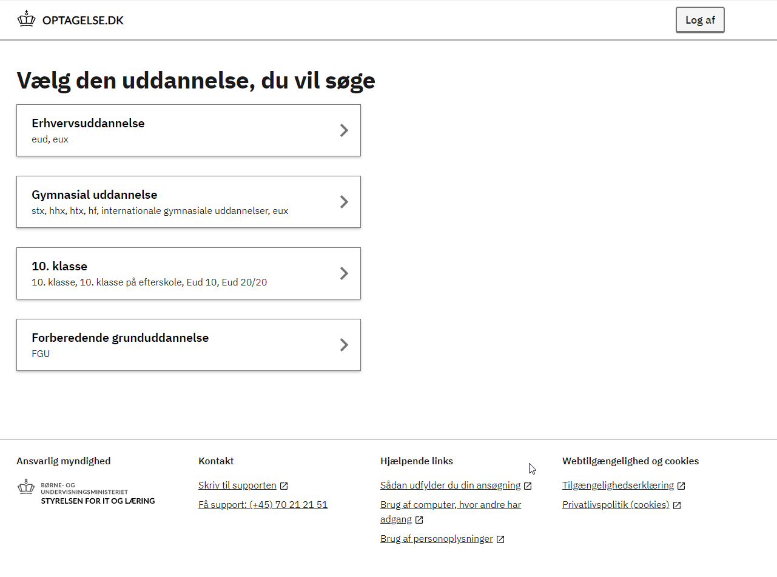
Click here for Pre-IB or IB

Slide 7
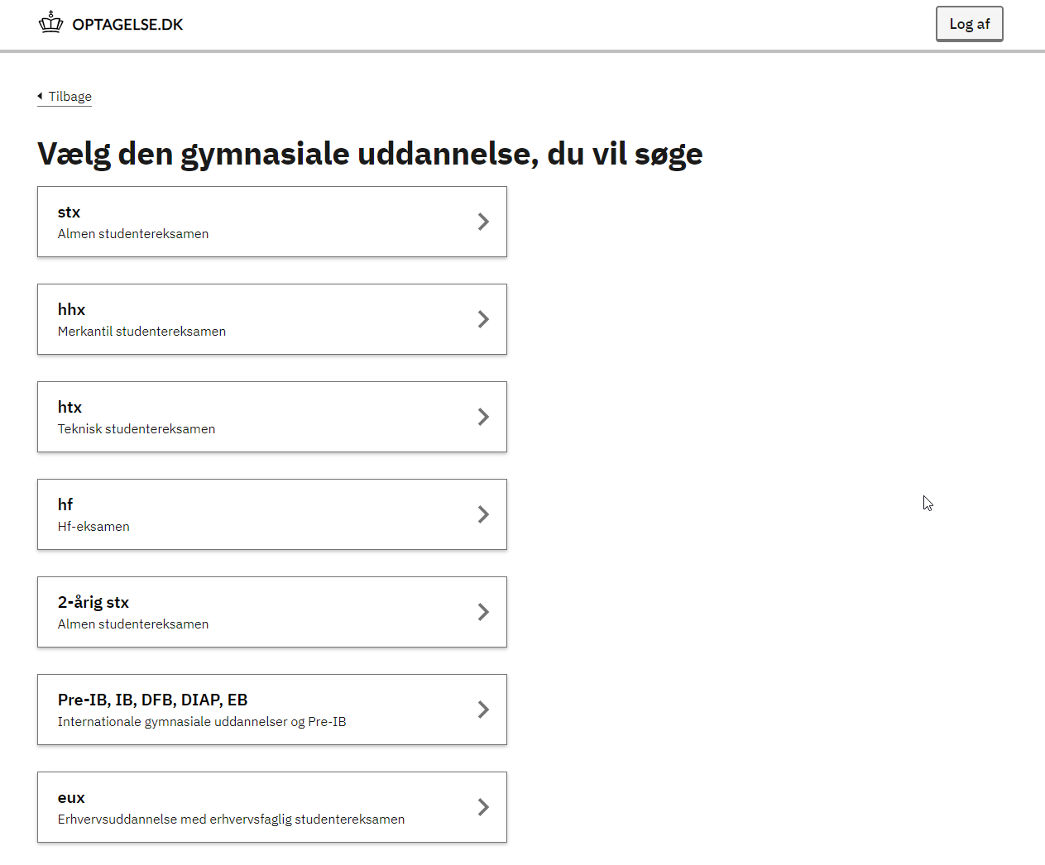
Click here for Pre-IB or IB

Slide 8
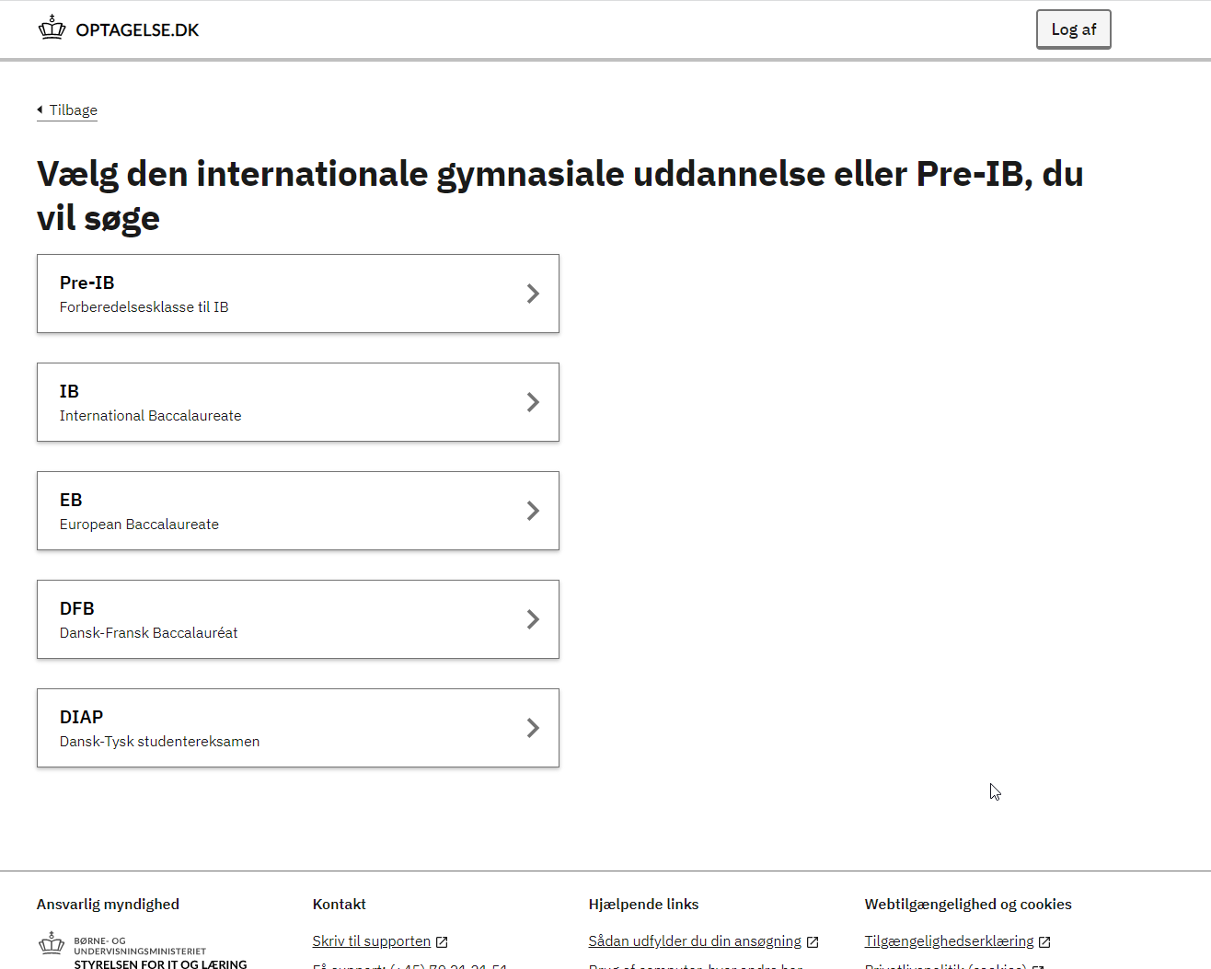
Click here to apply to Pre-IB. Please remember also to
apply via our own online application form on our
website.
If applying to the IB Diploma Programme, you only need
to apply via optagelse.dk if you are also applying to a
Danish educational programme (stx, hhx etc.).

Slide 9
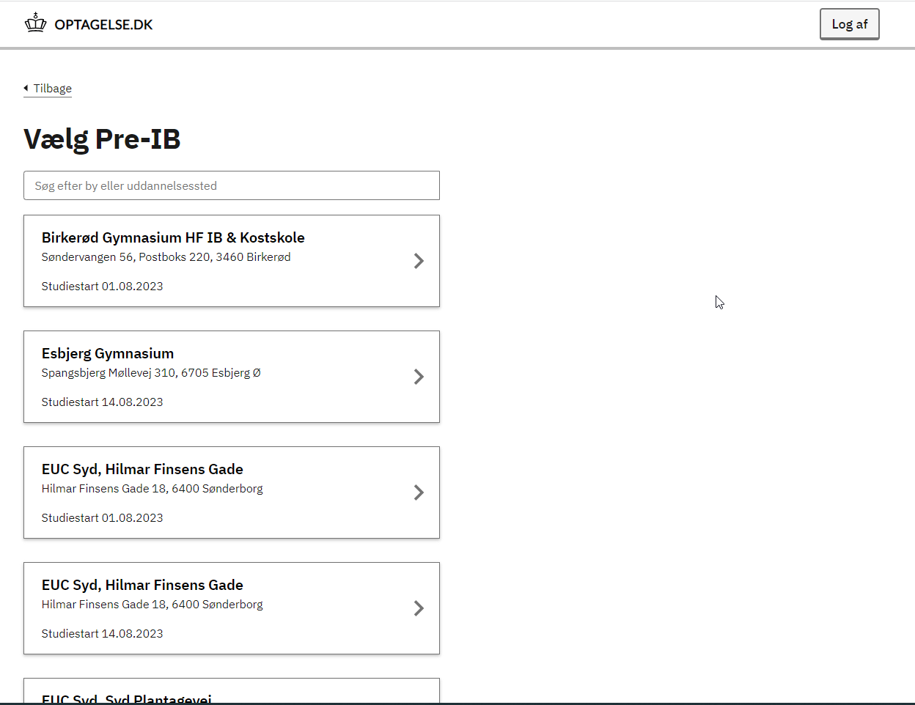
Click on the school which
you wish to apply to as
your first priority

Slide 10
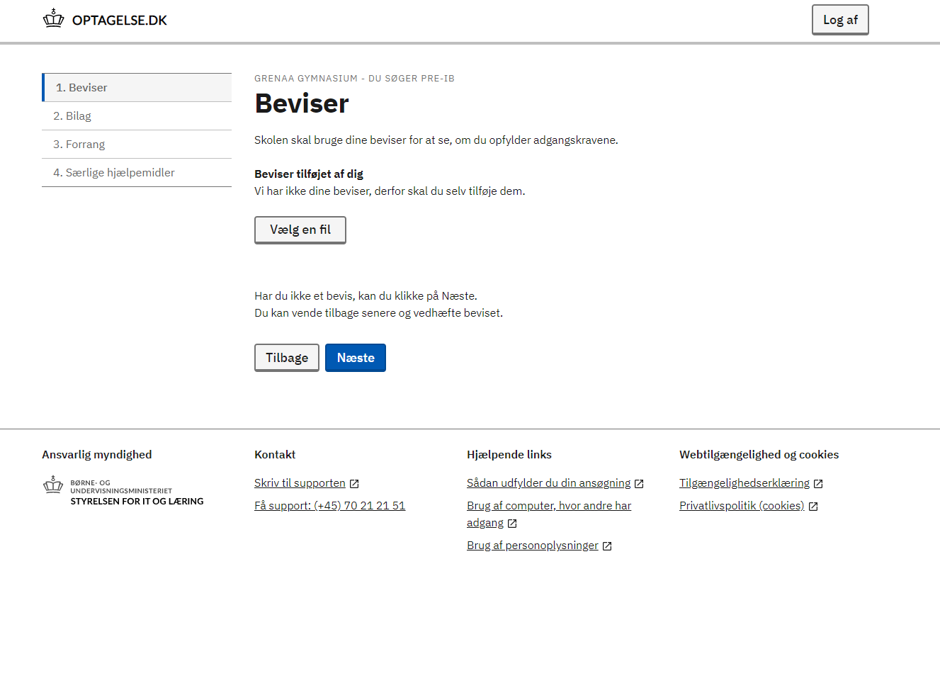
Click here to upload your
latest report card.
Then click ”Næste” (”Next”), also on
the following pages.

Slide 11
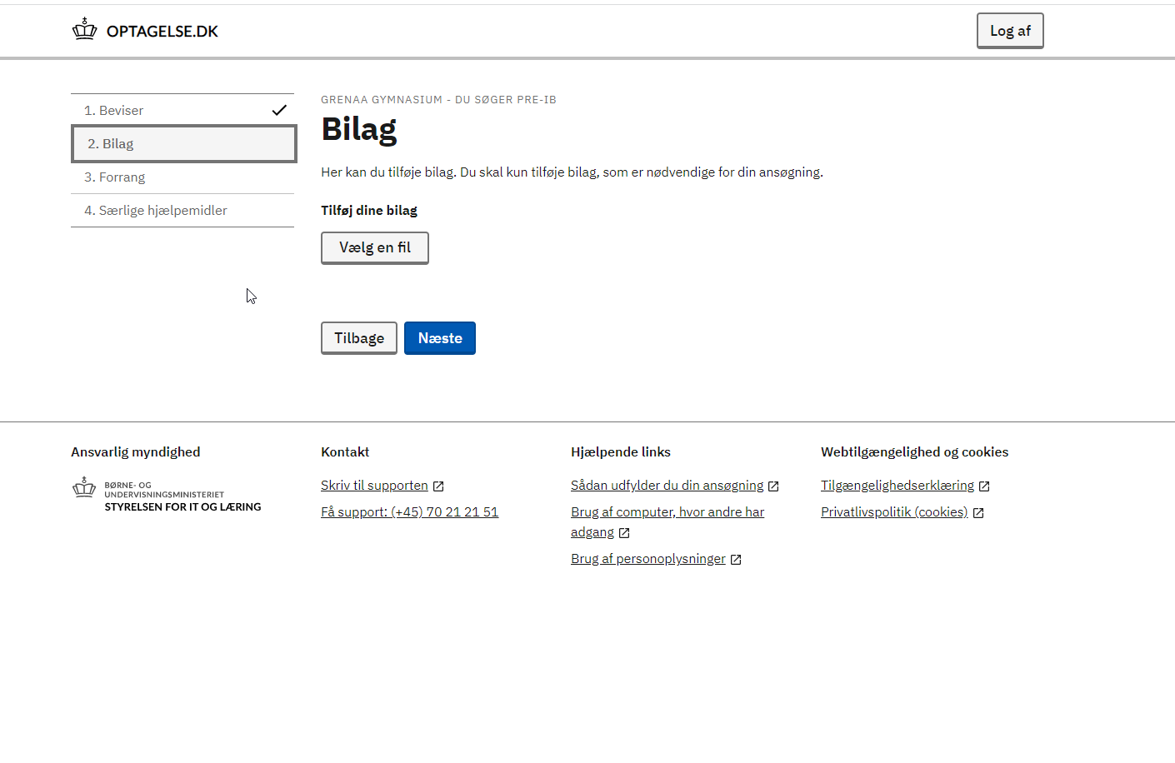
Click here to upload
additional documents, e.g.
a letter of recommendation
or studieportefølje if also
applying for stx, htx etc.
NB! You must also upload a
signed parent consent
form if you are logging in with
a sms code, see slide 4.

Slide 12
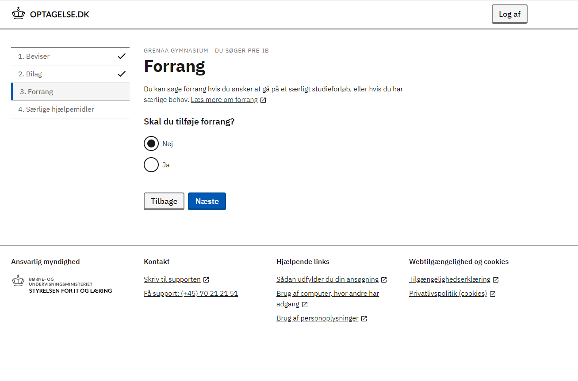
Click ”Ja” (”Yes”) here if also
applying to the boarding school.

Slide 13
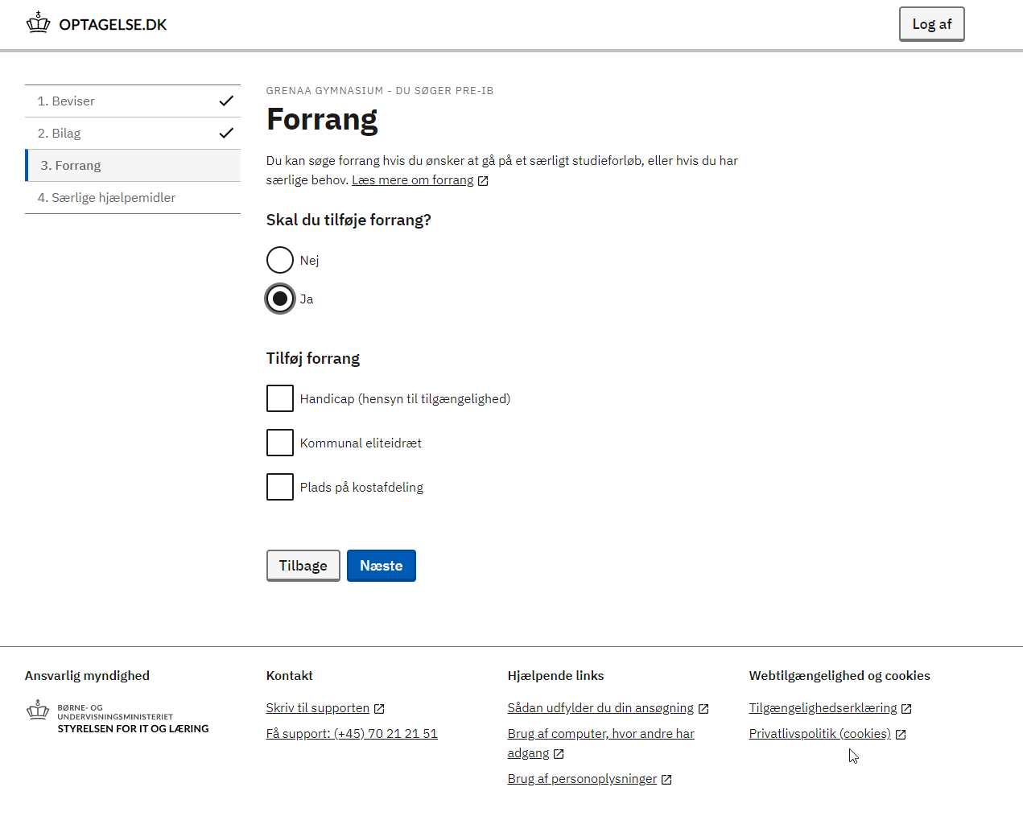
Click here if also applying to the boarding school.

Slide 14
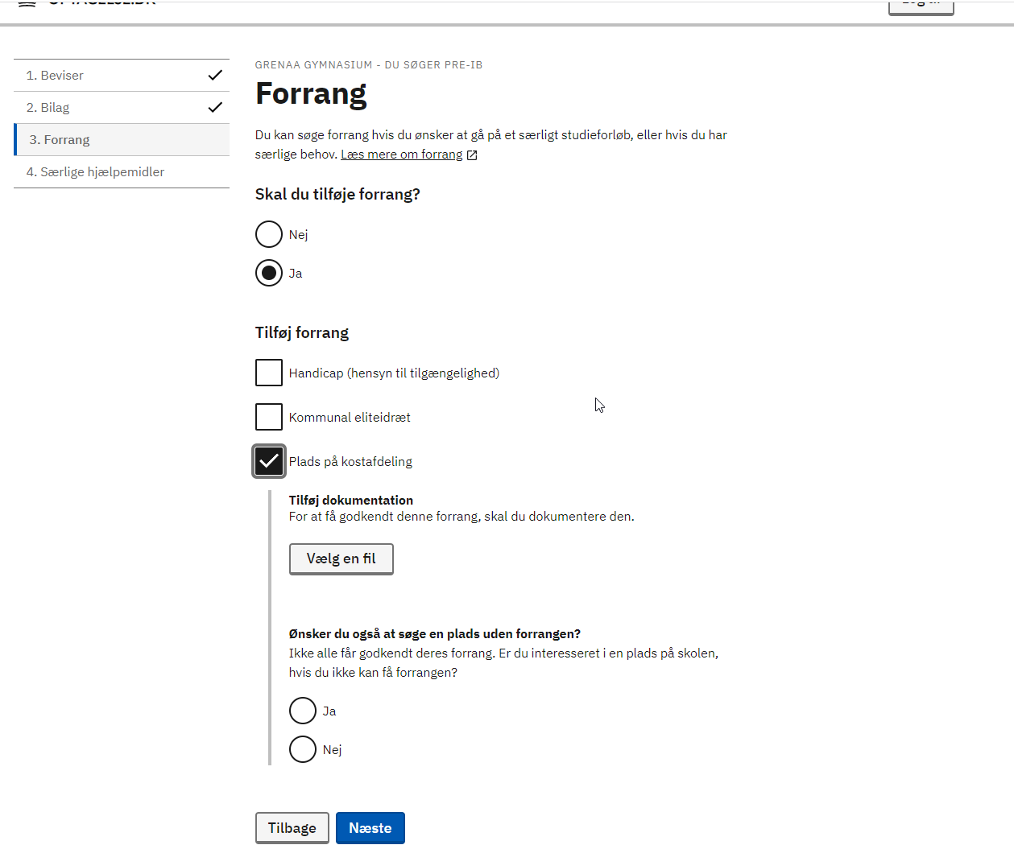
Upload proof of applying for
boarding or acceptance at
boarding.

Slide 15
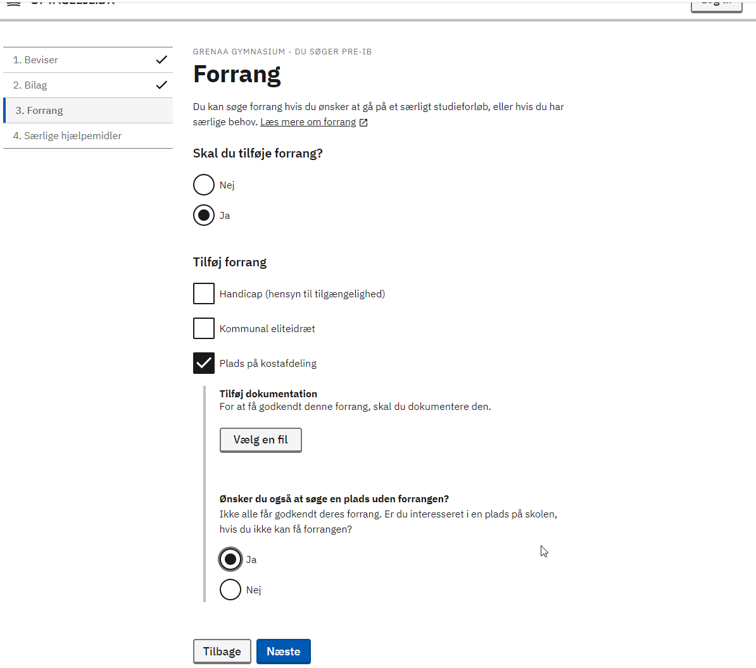
Click ”Ja” (”Yes”) here if you
wish a place at the day school
even though you do not get
accepted into the boarding
school.

Slide 16
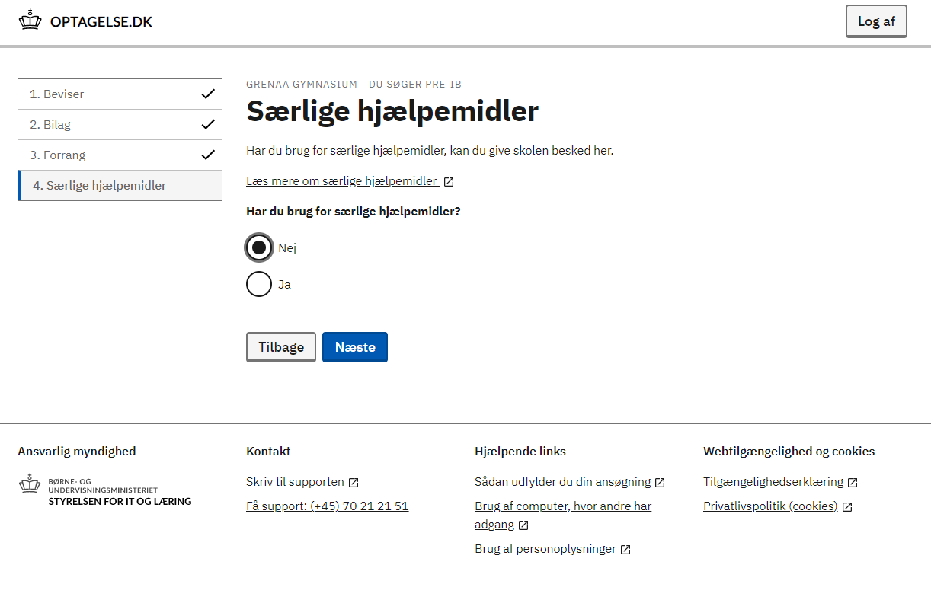
Click ”Ja” (”Yes”) here if you
have special needs.

Slide 17
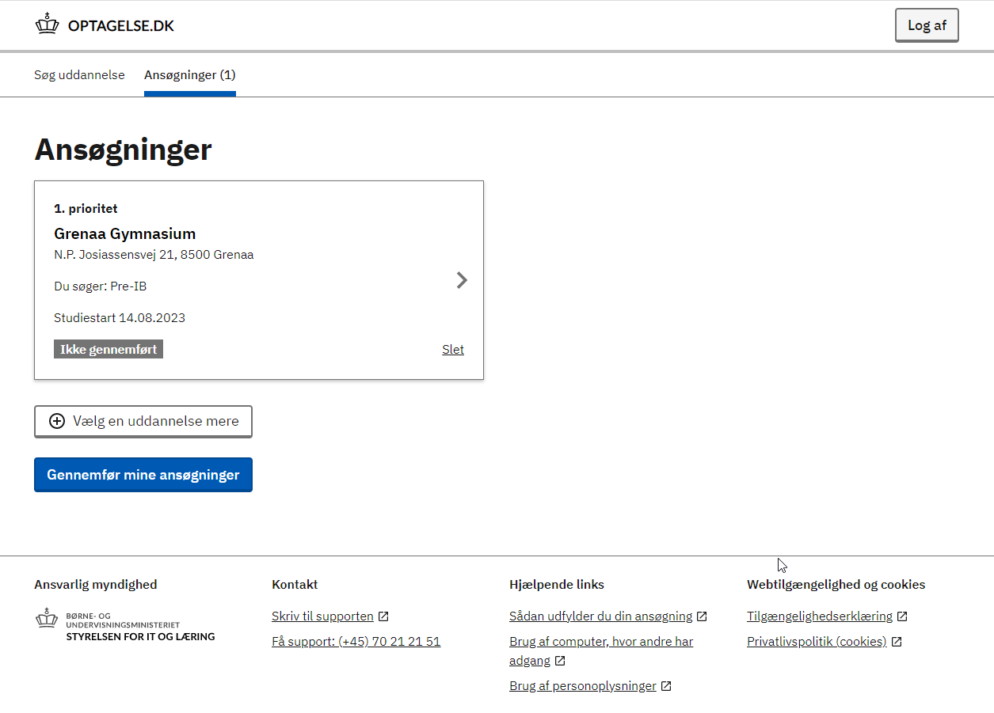
Click here to enter personal
data (name etc.).

Slide 18
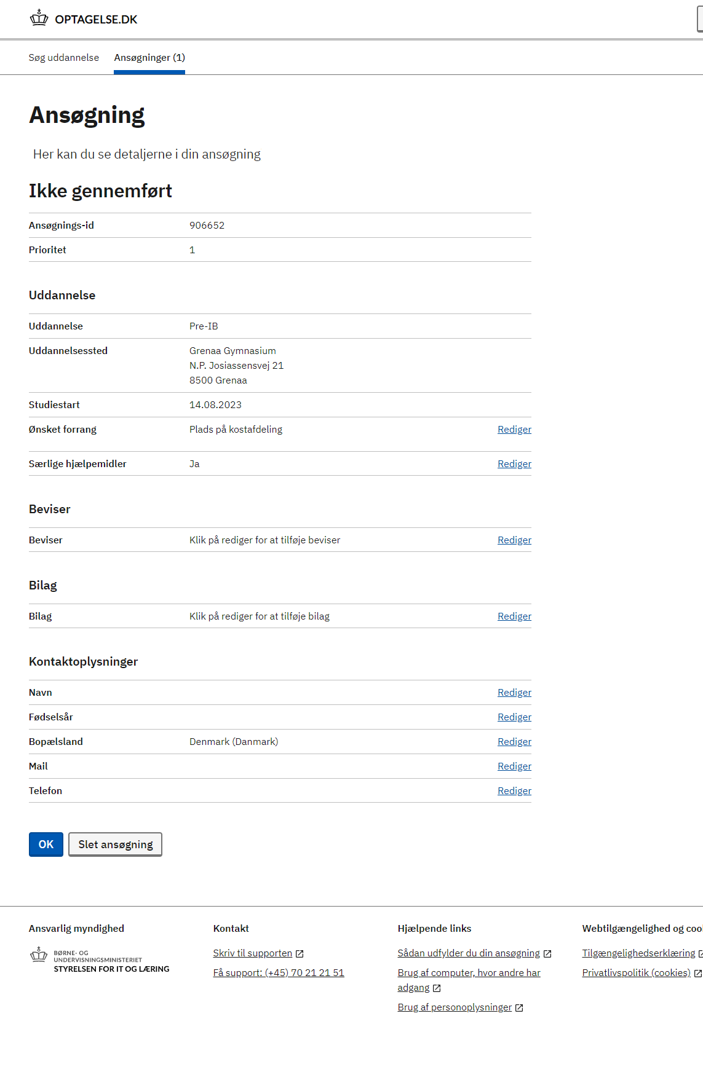
Click on ”Rediger” (”Edit”) here to enter
personal data (name etc.):
- ”Navn” = Name
- ”Fødselsår” = Birth date
- ”Bopælsland” = Country of residence
- ”Mail” = e-mail address
- ”Telefon” = Telephone number

Slide 19
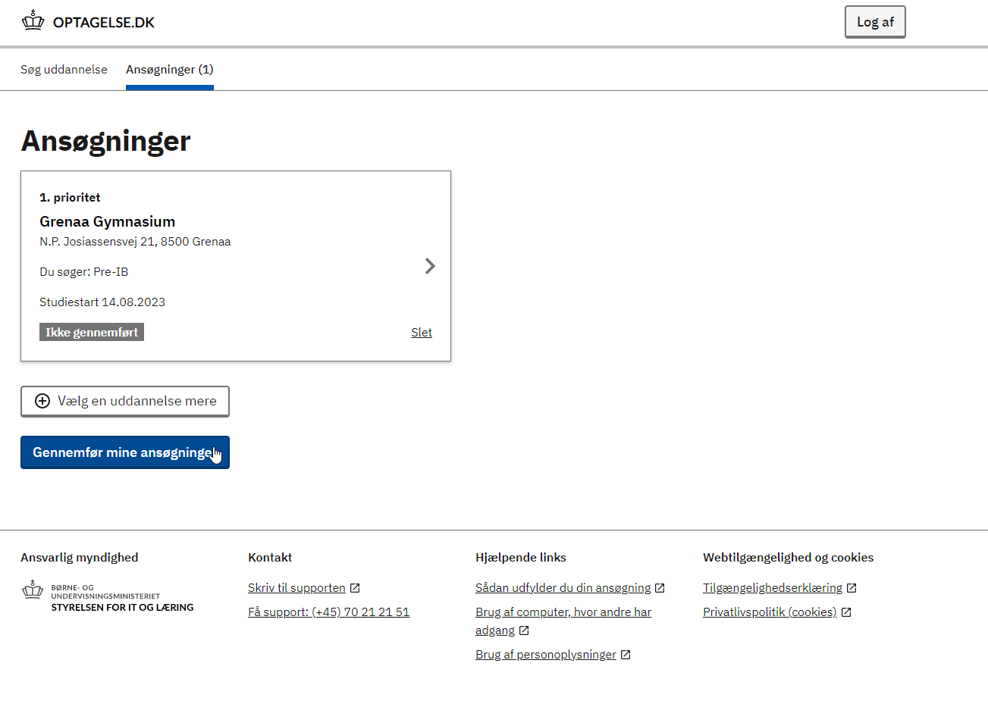
Click here to enter 2nd and
3rd priority schools

Slide 20
Click here to submit your
application when you have
finished it.

